Slide 1
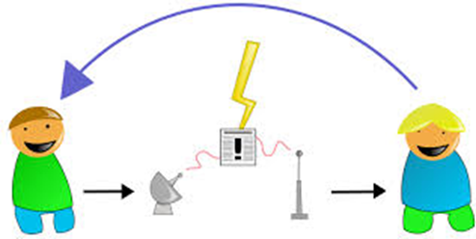

What is the internet?
The vast collection of inter-connected networks that are connected using the TCP/IP protocols . The Internet connects tens of thousands of independent networks into a vast global internet and is probably the largest Wide Area Network in the world.
.................................

Slide 2
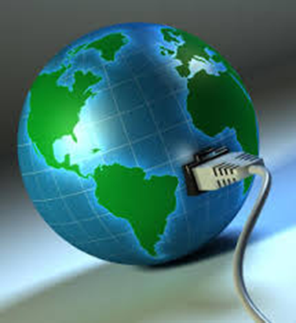
Search Engines
computer program that retrieves documents or files or data from a database or from a computer network (especially from the internet)

Slide 3
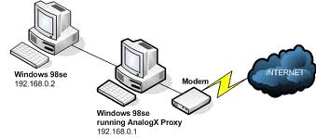
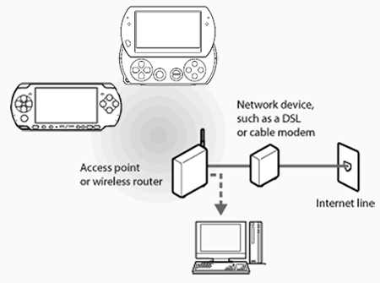
Connecting to the internet

Slide 4
Devices
Computer/ Internet enabled device
ISP
Connectivity can take place through Wired technology or wireless technology

Slide 5
This is an example of an HTTP URL: http://www.research.ibm.com/software/htp/cics/index.html If a port number was specified, the URL would be: http://www.research.ibm.com:1030/software/htp/cics/index.html
URL

Slide 6
Activity
Explain the terminology on the following slide

Slide 7
Terminology:
Internet -
Related Terms
broadband
dialup
IP
LAN
WAN
WWW
E-Communication
Hyperlink
Content Aggregator

